Slide 1
Floodlight and connection with Mininet

Slide 2
Install Mininet
cd floodlight
Ant
Sudo mkdir /var/lib/floodlight
Sudo chmod 777 /var/lib/floodlight

Slide 3
Running floodlight
Java –jar target/floodlight.jar

Slide 4
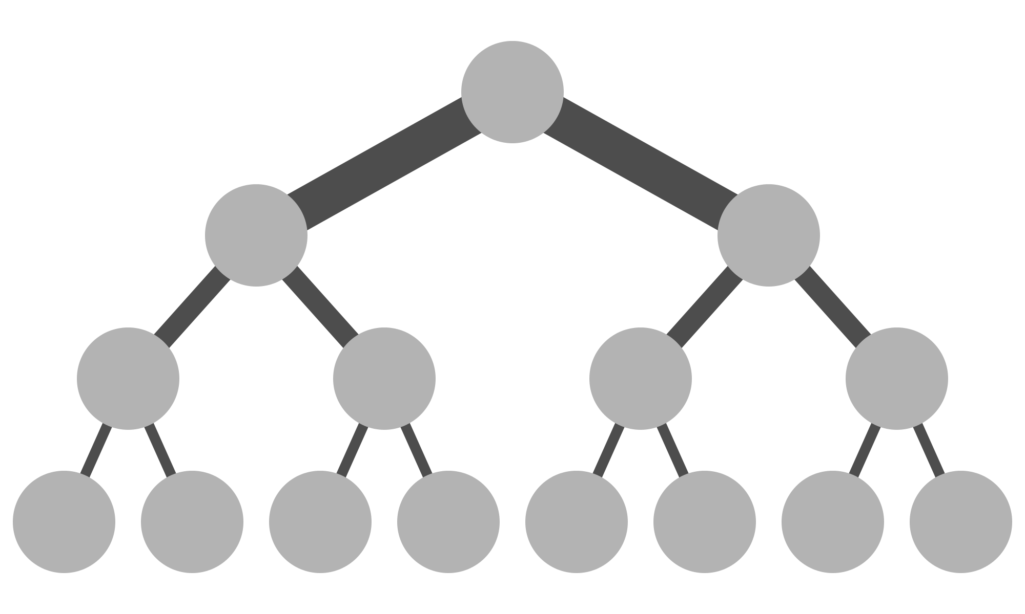
Fat-tree topology

Slide 5
Running topology
Sudo mn --custom {directory} --topo=mytopo --controller=remote
Sudo python {directory} --controller=remote

Slide 6
Rule in floodlight
curl -d '{"switch": "00:00:00:00:00:00:00:01", "name":"flow-mod-1", "priority":"32768", "in-port":"1","active":"true", "actions":"output=2"}' http://<controller_ip>:8080/wm/staticflowpusher/json

Slide 7
Rule in floodlight
http://<controller_ip>:8080/wm/staticflowpusher/list/<switch>/json for all switch use "all" "staticflowentrypusher"old! "staticflowpusher"new!

Slide 8
Rule in floodlight (shortest path)
http://<cotoroller_IP>:8080/wm/topology/route/src_id/src_port/dst_id/dst_port/json

Slide 9
flows
curl http://<controller_ip>:8080/wm/core/switch/1/flow/json;

Slide 10
Delete flows
curl -X DELETE -d '{"name":"flow-mod-1"}' http://<controller_ip>:8080/wm/staticflowentrypusher/json

